Slide 1

Array
Opentechz Pvt Ltd .
By Parthasarathi Swain

Slide 2

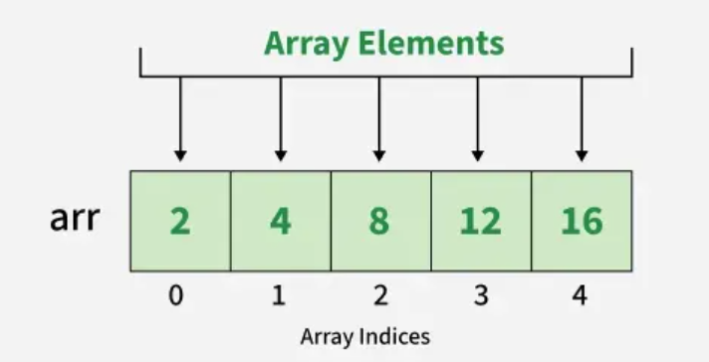
What is an Array?
An array is a fixed-size sequential collection of elements of the same data type.
Each element is stored in continuous memory.
Accessed using index numbers (0 to size-1).
Supports random access using index.
Example: int marks[5]; stores 5 integers.

Slide 3
Why Use Arrays?
Avoids declaring multiple variables.
Easy to manage large amounts of data.
Useful in loops, searching, sorting, matrices, etc.
Arrays reduce code length and complexity.
Data stored in a structured manner.
Without Array:
With Array:
int m1=10;
int m2=20;
int m3=30;
int m4=40;
int m5=50;
int arr[5] = {10, 20, 30, 40, 50};

Slide 4
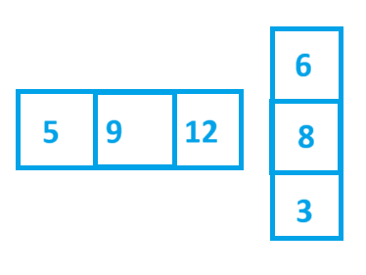
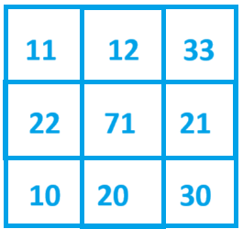
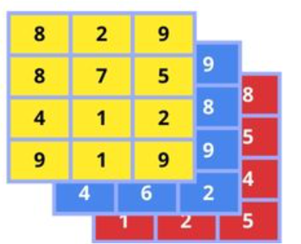
Types of Arrays in C++
One-Dimensional Array (1D)
Stores data in a single row.
Syntax: int arr[5];
Example: int marks[5] = {90, 85, 75, 88, 92};
Two-Dimensional Array (2D)
Stores data in rows and columns (like a table).
Syntax: int arr[3][3];
Example: int matrix[2][2] = {{1, 2}, {3, 4}};
Multidimensional Array
Arrays with 3 or more dimensions.
Syntax: int arr[2][3][4];
Example: Often used in scientific or 3D data.

Slide 5
One-Dimensional Array (1D)
A 1D (One-Dimensional) Array in C++ is a collection of elements of the same data type, stored in contiguous memory locations, and accessed using an index.
Declaration Only:
int arr[5]; // Uninitialized array of 5 integers
Declaration with Initialization:
int arr[5] = {10, 20, 30, 40, 50}; // Initialize with values
Let Compiler Count Size
int arr[] = {5, 10, 15, 20}; // Compiler sets size = 4
Partial Initialization:
int arr[5] = {1, 2}; // Remaining elements = 0

Slide 6
Important Points
Array index starts from 0 to size-1.
All elements must be of the same data type.
Stored in contiguous memory.
Array name is a pointer to the first element.
Access using: arr[index].

Slide 7
Size of Array
Method 1: Using sizeof() (Works in all C++ versions)
Size = sizeof(arr) / sizeof(arr[0])
int arr[] = {10, 20, 30, 40, 50};
sizeof(arr) → 5 elements × 4 bytes each = 20 bytes
sizeof(arr[0]) → size of first element (int) = 4 bytes
So, sizeof(arr) / sizeof(arr[0]) = 20 / 4 = 5
Method 2: Using std::size() (C++17 and above)
Size = std::size(arr);
int arr[] = {10, 20, 30, 40, 50};
int size = std::size(arr); // size=5

Slide 8
1. Input & Print Elements
#include <iostream>
using namespace std;
int main() {
int arr[5];
cout << "Enter 5 elements: ";
for(int i = 0; i < 5; i++) {
cin >> arr[i];
}
cout << "Array elements are: “<<endl;
for(int i = 0; i < 5; i++) {
cout << arr[i] << " ";
}
return 0;
}
Array elements are:
10 20 30 40 50

Slide 9
2. Sum of Elements
#include <iostream>
using namespace std;
int main() {
int arr[5] = {10, 20, 30, 40, 50}, sum = 0;
for(int i = 0; i < 5; i++) {
sum += arr[i];
}
cout << "Sum = " << sum;
return 0;
}
Sum = 150

Slide 10
3.Find Maximum Element
#include <iostream>
using namespace std;
int main() {
int arr[5] = {25, 10, 45, 30, 5}, max = arr[0];
for(int i = 1; i < 5; i++) {
if(arr[i] > max)
max = arr[i];
}
cout << "Maximum = " << max;
return 0;
}
Maximum = 45

Slide 11
4. Reverse Array Print
#include <iostream>
using namespace std;
int main() {
int arr[5] = {1, 2, 3, 4, 5};
cout << "Reverse: ";
for(int i = 4; i >= 0; i--) {
cout << arr[i] << " ";
}
return 0;
}
Reverse: 5 4 3 2 1

Slide 12
5. Count Even and Odd Elements
#include <iostream>
using namespace std;
int main() {
int arr[6] = {2, 5, 8, 9, 4, 11}, even = 0, odd = 0;
for(int i = 0; i < 6; i++) {
if(arr[i] % 2 == 0)
even++;
else
odd++;
}
cout << "Even = " << even << ", Odd = " << odd;
return 0;
}
Even = 3, Odd = 3

Slide 13
Two-Dimensional Array (2D)
A 2D array in C++ is an array of arrays (like a table) with rows and columns. It is used to store data in a matrix form.
Declaration Only:
int arr[3][3]; // 3 rows, 3 columns, uninitialized
Declaration with Initialization:
int arr[2][2] = {{1, 2}, {3, 4}};
Initialization in One Line:
int arr[2][1] = {1, 2, 3, 4, 5, 6}; // row-wise filling

Slide 14
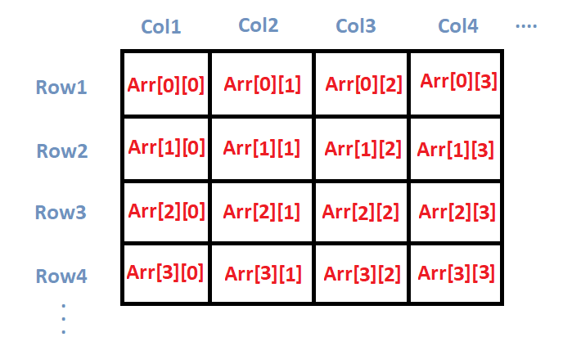
Important Points
Accessed using 2 indexes: arr[row][column]
Useful for representing matrices, tables, grids
Stored in row-major order (row by row)
Can be used in nested loops for input/output

Slide 15
1. Input and Print 2D Array
#include <iostream>
using namespace std;
int main() {
int arr[2][2];
cout << "Enter 4 elements:\n";
for(int i = 0; i < 2; i++)
for(int j = 0; j < 2; j++)
cin >> arr[i][j];
cout << "Matrix:\n";
for(int i = 0; i < 2; i++) {
for(int j = 0; j < 2; j++)
cout << arr[i][j] << " ";
cout << endl;
}
return 0;
}
Matrix:
1 2
3 4

Slide 16
2. Sum of All Elements
#include <iostream>
using namespace std;
int main() {
int arr[2][3] = {{1, 2, 3}, {4, 5, 6}};
int sum = 0;
for(int i = 0; i < 2; i++)
for(int j = 0; j < 3; j++)
sum += arr[i][j];
cout << "Sum = " << sum;
return 0;
}
Sum = 21

Slide 17
3. Print Row-wise Sum
#include <iostream>
using namespace std;
int main() {
int arr[2][3] = {{1, 2, 3}, {4, 5, 6}};
for(int i = 0; i < 2; i++) {
int rowSum = 0;
for(int j = 0; j < 3; j++)
rowSum += arr[i][j];
cout << "Sum of row " << i + 1 << " = " << rowSum << endl;
}
return 0;
}
Sum of row 1 = 6
Sum of row 2 = 15

Slide 18
4. Transpose of 2D Array
#include <iostream>
using namespace std;
int main() {
int arr[2][3] = {{1, 2, 3}, {4, 5, 6}};
cout << "Transpose:\n";
for(int j = 0; j < 3; j++) {
for(int i = 0; i < 2; i++)
cout << arr[i][j] << " ";
cout << endl;
}
return 0;
}
Transpose:
1 4
2 5
3 6

Slide 19
5. Find Maximum Element
#include <iostream>
using namespace std;
int main() {
int arr[2][2] = {{8, 15}, {3, 12}};
int max = arr[0][0];
for(int i = 0; i < 2; i++)
for(int j = 0; j < 2; j++)
if(arr[i][j] > max)
max = arr[i][j];
cout << "Maximum = " << max;
return 0;
}
Maximum = 15

